Slide 1
Introduction to Data Science

Slide 2
Introduction to data visualization

Slide 3
What is data visualization?
Data visualization refers to the graphical representation of data by visual elements such as charts, infographics, and maps to understand the data. There is a story behind every data, and data visualization brings them to life. It enables decision-makers, stakeholders or your readers to see data analytics presented visually, so they can grasp difficult concepts or identify new patterns.

Slide 4
What is data visualization?
According to English Language adage, a picture is worth a thousand words. Our eyes are easily drawn to colours and pattern. Data visualization helps grab the readers' interest and keeps their eyes on the message of the data.

Slide 5
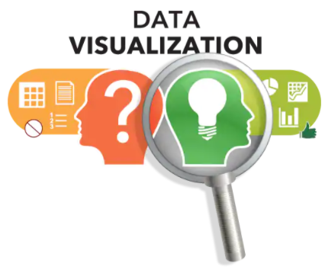
Why data visualization?
The importance of Data Visualization is as follows:
It is a powerful way to explore data with presentable results
It displays the summary of our data at a glance
Charts and graphs make it easier to identify patterns and trends
It helps to identify areas that need attention or improvement.
It can be hard for the audience to grasp the true meaning of the findings without data visualization.

Slide 6
Before you visualize your data
Presentation of data and information is not just about picking any data visualization design. Matching data to the right visualization begins by answering the following five (5) key questions:

Slide 7
Before you visualize your data
1. What relationship am I trying to understand between my data sets?
2. Do I want to understand the distribution of data and look for outliers?
3. Am I looking to compare multiple values or looking to analyze a single value over time?
4. Am I interested in analyzing trends in my data sets?
5. Is this visualization an important part of my overarching data story?

Slide 8
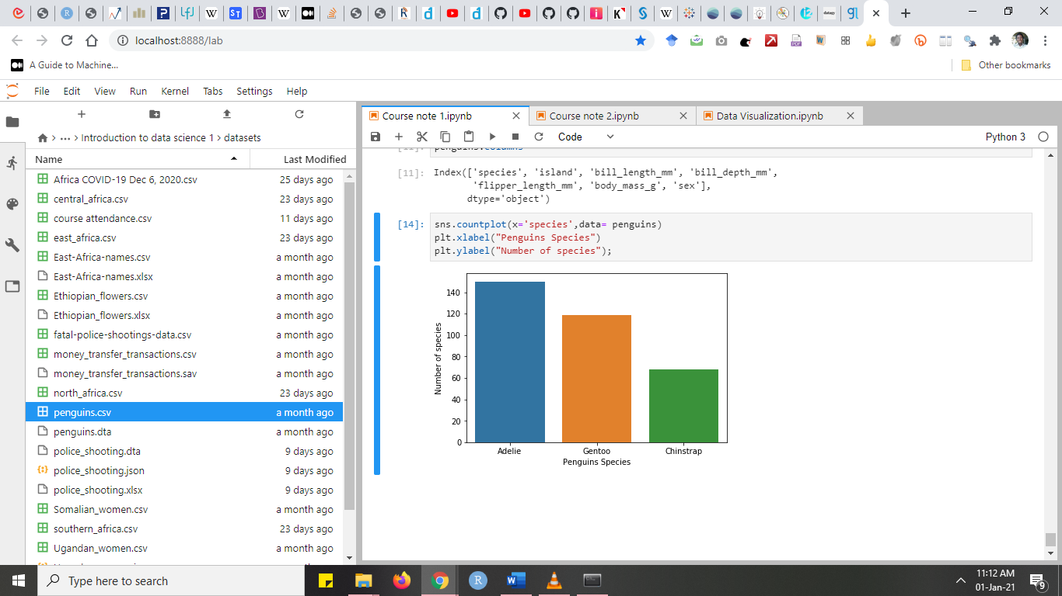
Data Visualization Techniques
Name: Bar chart
Visual dimensions:
length/count
category
color

Slide 9
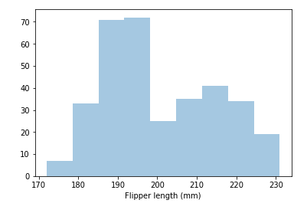
Data Visualization Techniques
Name: Histogram
Visual dimensions:
bin limits
count/length
color

Slide 10
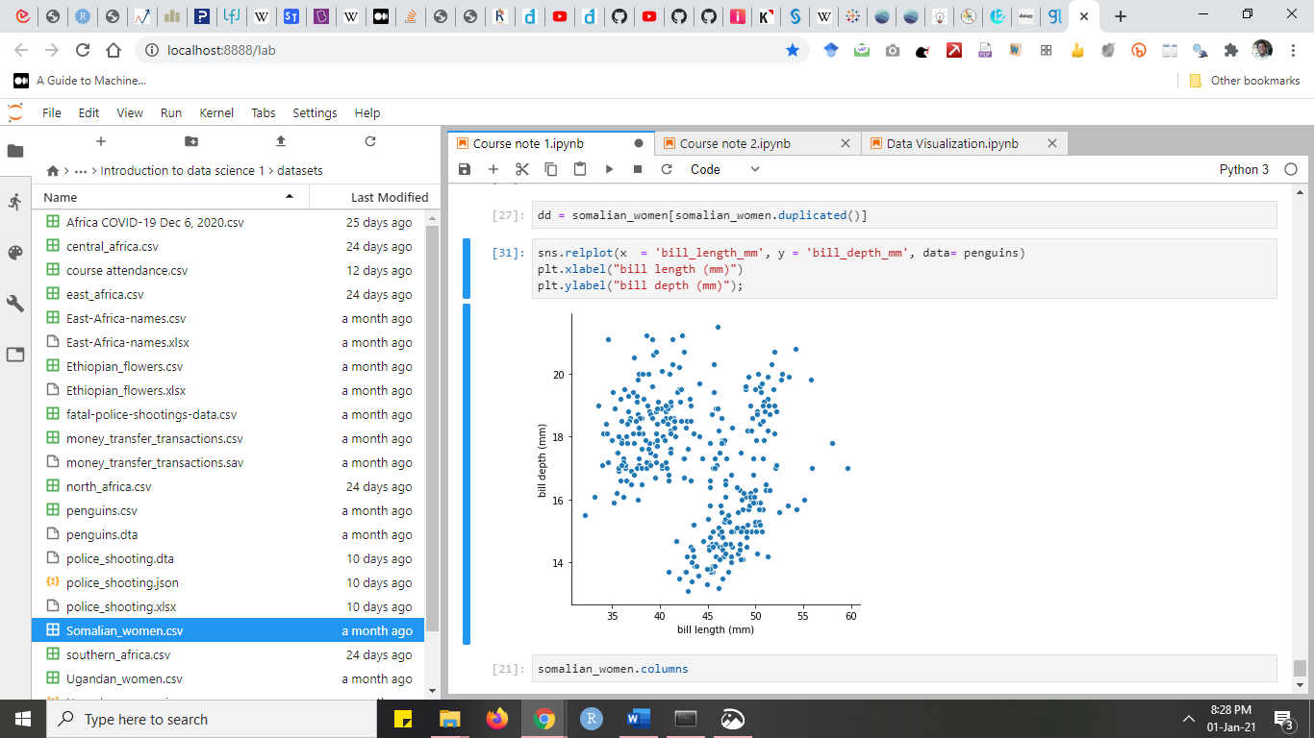
Data Visualization Techniques
Name: Scatter plot
Visual dimensions:
x position
y position
shape
color
size

Slide 11
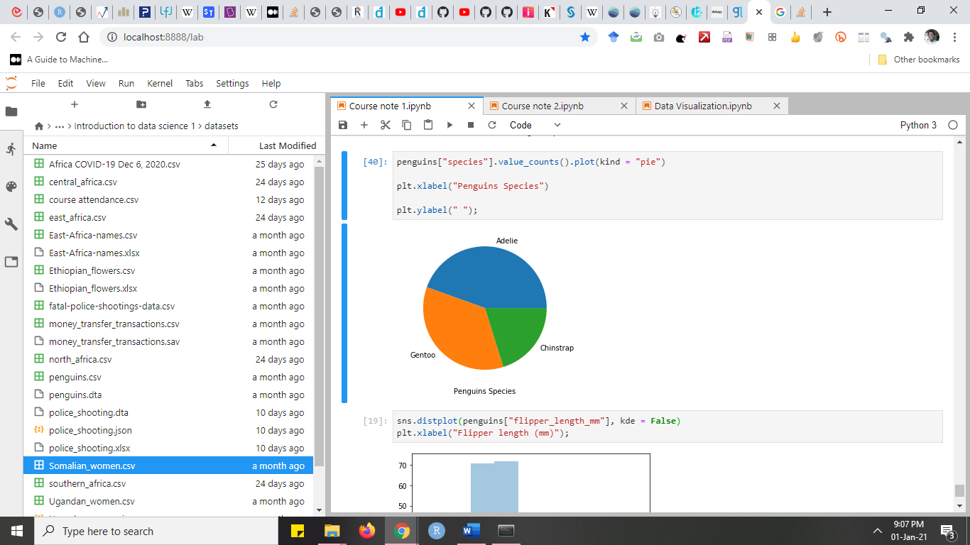
Data Visualization Techniques
Name: Pie chart
Visual dimensions:
color

Slide 12
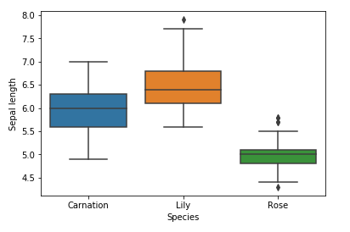
Data Visualization Techniques
Name: Box and Whisker Plot
Visual dimensions:
x axis
y axis

Slide 13
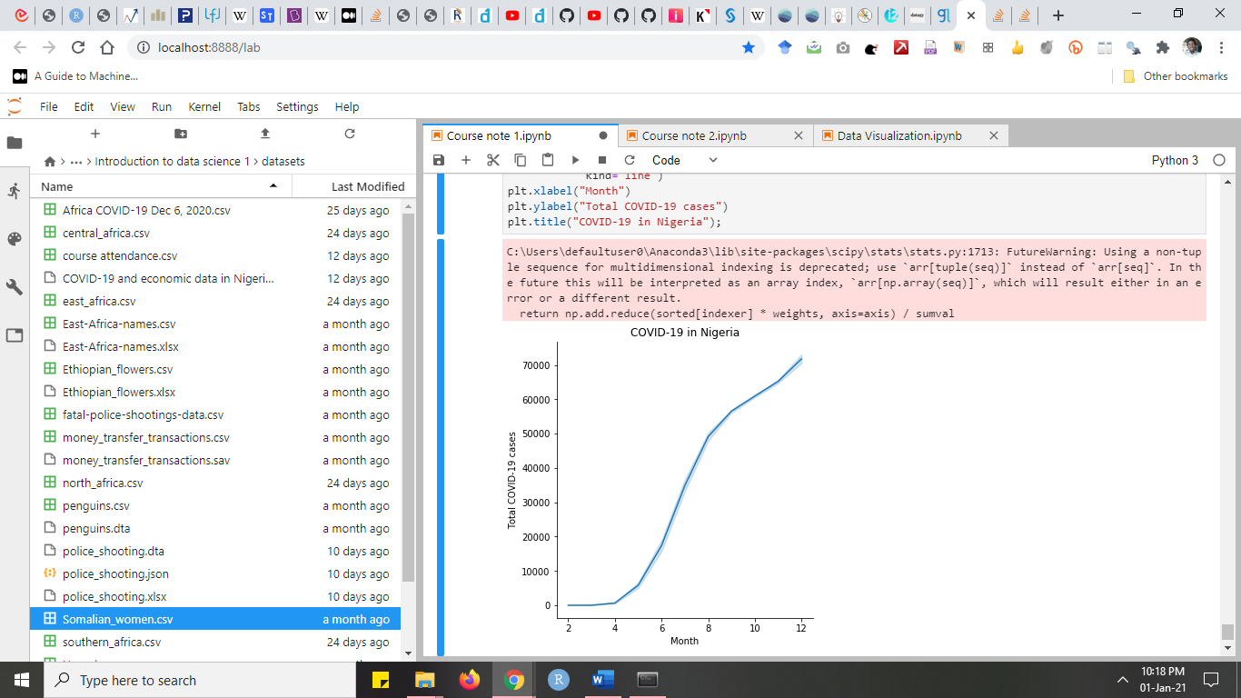
Data Visualization Techniques
Name: Line chart
Visual dimensions:
x position
y position
shape
color
size

Slide 14
Data visualization packages
There are many tools/packages for data visualization in Python programming. Some of them are as follows:
Matplotlib produces publication quality figures in a variety of hardcopy formats and interactive environments across platforms; you can generate plots, histograms, bar charts, line chart, scatterplots, etc. with just a few lines of code.
Seaborn is a Python data visualization library based on matplotlib. It provides a high-level interface for drawing attractive and informative statistical graphics.

Slide 15
Data visualization packages
Plotly generates the most interactive graphs; allows saving them offline and create very rich web-based visualizations
Pandas also possesses its own data visualization functionalities based on Matplotlib.

Slide 16
Data visualization packages
We will consider using Seaborn and Pandas for data visualization. We will also consider using some functions in matplotlib package, since Seaborn and Pandas based their visualization on matplotlib

Slide 17
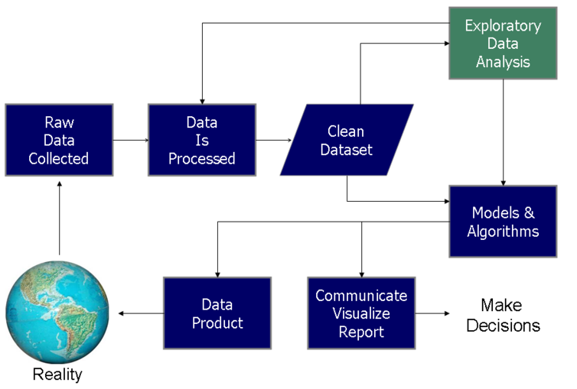
Summary

Slide 18

Lab session

